Slide 1
Chapter Four
The Theory of Production and Cost

Slide 2
Chapter objectives
you will be able to:
define production and production function
differentiate between fixed and variable inputs
describe short run total product, average product and marginal product
compare and contrast the three stages of production in the short run
explain the difference between accounting cost and economic cost
describe total cost, average cost and marginal cost functions
explain the relationship between short run production functions and short run cost functions

Slide 3
4.1 Theory of production in the short run
Production
is the process of transforming inputs into outputs.
It is an act of creating value or utility.
Production function
is a technical relationship between inputs and outputs.
shows the maximum output that can be produced with fixed amount of inputs and the existing technology.
A general production function can be described as:
Q= f(X1, X2, X3,…, Xn )
where, Q is output and X1, X2, X3,…, Xn are different types of inputs.

Slide 4
Outputs -the end products of the production process.
could be tangible (goods) or intangible (services).
Inputs includes land, labour, capital and entrepreneurial ability, which are used to transform raw materials into outputs.
commonly classified as
i) Fixed inputs
inputs whose quantity cannot readily be changed when market conditions indicate that an immediate adjustment in output is required.
In fact, no input is ever absolutely fixed but may be fixed during an immediate requirement.
Ex. Buildings, land and machineries.

Slide 5
ii) Variable inputs
inputs whose quantity can be altered almost instantaneously in response to desired changes in output.
their quantities can easily be diminished when the market demand for the product decreases and vice versa.
Ex. unskilled labour.
In economics, economic periods of production are classified
a) Short run a period of time in which the quantity of at least one input is fixed.
a time period which is not sufficient to change the quantities of all inputs so that at least one input remains fixed.
b) Long Run a period of time in which the quantity of all input is variable.

Slide 6
Different firms have different Short run and long run periods of durations. Some firms can change the quantity of all their inputs within a month while it takes more than a year for other types of firms.
Consider a firm that uses two inputs: capital (fixed) and labour (variable). Given the assumptions of short run production, the firm can increase output only by increasing the amount of labour.
Hence, its production function can be given by:
Q = f (L) where, Q is output and L is the quantity of labour.
Output can be changed only when the amount of labour changes.
Thus the short run production function shows different levels of output that the firm can produce by efficiently utilizing different units of labour and the fixed capital.

Slide 7
Total, average, and marginal product
In short run, the contribution of a variable input can be described in-
Total product (TP)
is the total amount of output that can be produced by efficiently utilizing specific combinations of the variable input and fixed input.
Increasing the variable input (while some other inputs are fixed) can increase the total product only up to a certain point.
Initially, as we combine more and more units of the variable input with the fixed input, output continues to increase, but eventually if we employ more and more unit of the variable input beyond the carrying capacity of the fixed input, output tends to decline.
In general, the TP function in the short run initially increases at an increasing rate, then increases at a decreasing rate, reaches a maximum point and eventually falls as the quantity of the variable input rises.

Slide 8
Marginal Product (MP):
is the change in output attributed to the addition of one unit of the variable input to the production process, other inputs being constant.
The change in total output resulting from employing additional worker (holding other inputs constant) is the marginal product of labour (MPL).
measures the slope of the total product curve at a given point.
MPL=dTP/dL=ΔQ/ΔL
first increases, reaches its maximum and then decreases to the extent of being negative.
That is, as we continue to combine more and more of the variable input with the fixed input, the marginal product of the variable input increases initially and then declines.

Slide 9
Average Product (AP)
is the level of output that each unit of input produces, on the average.
the mean contribution of each variable input to the total product.
it is the ratio of total output to the number of the variable input.
The average product of labour (APL)
APL=TP/L
first increases, reaches its maximum value and eventually declines.
The shape of TP, MP,AP can be illustrated using the following graph

Slide 10
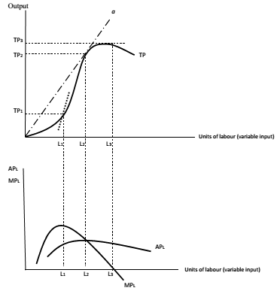
When APL is increasing, MPL > APL.
When APL is at its maximum, MPL = APL.
When APL is decreasing, MPL < APL.

Slide 11
Example:
Suppose that the short-run production function of certain cut-flower firm is given by: Q=4KL-0.6K² -0.1L²
where Q is quantity of cut-flower produced, L is labour input and K is fixed capital input (K=5).
Determine the APL function.
At what level of labour does the total output of cut-flower reach the maximum?
What will be the maximum achievable amount of cut-flower production?

Slide 12
The law of variable proportions(law of diminishing returns)
as successive units of a variable input(say, labour) are added to a fixed input (say, capital or land), beyond some point the MP that can be attributed to each additional unit of the variable resource will decline.
If additional workers are hired to work with a constant amount of capital equipment, output will eventually rise by smaller and smaller amounts as more workers are hired.
The law assumes that technology is fixed and thus the techniques of production do not change.
Moreover, all units of labour are assumed to be of equal quality.
Each successive worker is presumed to have the same innate ability, education, training, and work experience.

Slide 13
Marginal product ultimately diminishes because more workers are being used relative to the amount of plant and equipment available.
The law starts to operate after the marginal product curve reaches its maximum
Stages of production
Stage I:
Covers the range of variable input levels over which APL continues to increase.
From the origin to the MPL=APL where the APL is maximum.
is not an efficient region of production though the MP of variable input is positive.
Because the variable input (the number of workers) is too small to efficiently run the fixed input so that the fixed input is under-utilized (not efficiently utilized).

Slide 14
Stage II
ranges from the MPL=APL to the point where MPL is zero.
As the labour input increases, output still increases but at a decreasing rate.
stage of diminishing marginal returns.
MPL and APL are decreasing due to the scarcity of the fixed factor.
Once the optimum capital-labour combination is achieved, employment of additional unit of the variable input will cause the output to increase at a slower rate.
As a result, the marginal product diminishes.
This stage is the efficient region of production.
Additional inputs are contributing positively to the TP and MP of successive units of variable input is declining (indicating that the fixed input is being optimally used).

Slide 15
Stage III:
An increase in the variable input is accompanied by decline in the TP.
Thus, the TP curve slopes downwards, and the MPL becomes negative.
This stage is also known as the stage of negative marginal returns.
The cause of negative marginal returns is the fact that the volume of the variable inputs is quite excessive relative to the fixed input; the fixed input is over-utilized.
Arational firm should not operate in stage III because additional units of variable input are contributing negatively to the TP (MP of the variable input is negative).

Slide 16
4.2 Theory of costs in the short run
To produce goods and services, firms need factors of production or simply inputs.
To acquire these inputs, they have to buy them from resource suppliers.
Cost is, therefore, the monetary value of inputs used in the production of an item.
Explicit Cost and Implicit Cost
Economists use the term “profit” differently from the way accountants use it.
To the accountant, profit is the firm‘s total revenue less its explicit costs (accounting costs).
To the economist, economic profit is total revenue less economic costs (explicit and implicit costs).

Slide 17
Accounting cost
is the monetary value of all purchased inputs used in production.
It ignores the cost of non-purchased (self-owned) inputs.
It considers only direct expenses such as wages/salaries, cost of raw materials, depreciation allowances, interest on borrowed funds and utility expenses (electricity, water, telephone, etc.).
These costs are said to be explicit costs which are out of pocket expenses for the purchased inputs.
An accounting profit.
Accounting profit = Total revenue – Accounting cost
Total revenue – Explicit cost

Slide 18
Economic cost
considers all inputs (purchased and nonpurchased).
Calculating economic costs will be difficult since there are no direct monetary expenses for non-purchased inputs.
The monetary value of these inputs is obtained by estimating their opportunity costs in monetary terms.
The estimated monetary cost for non purchased inputs is known as implicit cost.
Economic cost is the sum of implicit cost and explicit cost.
Economic profit = Total revenue – Economic cost
(Explicit cost + Implicit cost)
Economic profit will give the real profit of the firm since all costs are taken into account.
Accounting profit of a firm will be greater than economic profit by the amount of implicit cost.

Slide 19
Total, average and marginal costs in the short run
A cost function shows the total cost of producing a given level of output. C = f (Q),
where C is the total cost of production and Q is level of output.
In the short run, total cost (TC) can be broken down in to two
Fixed costs
are costs which do not vary with the level of output.
are unavoidable regardless of the level of output.
The firm can avoid fixed costs only if he/she stops operation (shuts down the business).
May include salaries of administrative staff, expenses for building depreciation and repairs, expenses for land maintenance and the rent of building used for production.

Slide 20
ii) Variable costs
costs which directly vary with the level of output.
If the firm produces zero output, the variable cost is zero.
may include the cost of raw materials, the cost of direct labour and the running expenses of fuel, water, electricity, etc
The short run total cost is given by the sum of total fixed cost and total variable cost.
TC = TFC + TVC

Slide 21
TFC is denoted by a straight line parallel to the output axis. because such costs do not vary with the level of output.
TVC has an inverse S-shape which indicates the law of variable proportions in production.
At the initial stage of production with a given plant, as more of the variable factor is employed, its productivity increases. Hence, the TVC increases at a decreasing rate.
This continues until the optimal combination of the fixed and variable factor is reached.
Beyond this point, as increased quantities of the variable factor are combined with the fixed factor, the productivity of the variable factor declines, and the TVC increases at an increasing rate.
TC curve is obtained by vertically adding TFC and TVC at each level of output.

Slide 22
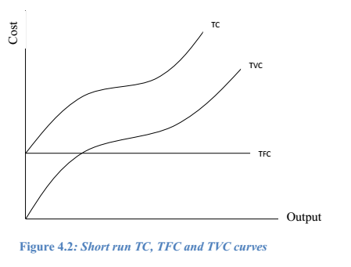
The shape of the TC curve follows the shape of the TVC curve, i.e. the TC has also an inverse S-shape.
It should be noted that when the level of output is zero, TVC is also zero which implies TC = TFC.

Slide 23

Per unit costs
Average fixed cost (AFC) - is total fixed cost per unit of output.
AFC = TFC/ Q
declines continuously and approaches both axes asymptotically.
Average variable cost (AVC) - is total variable cost per unit of output.
AVC = TVC/ Q
has U-shape falls initially, reaches its minimum, and then starts to increase- the law of variable proportions.
Average total cost (ATC) or simply Average cost (AC) is the total cost per unit of output.
AC = TC/ Q

Slide 24


Marginal Cost (MC)
is the additional cost that a firm incurs to produce one extra unit of output.
It is the change in total cost which results from a unit change in output.
is also a change in TVC with respect to a unit change in the level of output.
is the slope of TC function
U shaped-initially decreases, reaches its minimum and then starts to rise-the law of variable proportions.

Slide 25
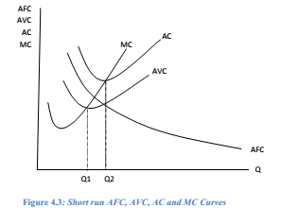
AVC curve reaches its minimum point at Q1 level of output and AC reaches its minimum point at Q2.
The vertical distance between AC and AVC i.e. AFC decreases continuously as output increases.
MC curve passes through the minimum points of both AVC and AC curves.

Slide 26
Example:
Suppose the short run cost function of a firm is given by:
TC=2Q³ –2Q² + Q + 10
Find the expression of TFC & TVC
Derive the expressions of AFC, AVC, AC and MC
Find the levels of output that minimize MC and AVC and then find the minimum values of MC and AVC

Slide 27
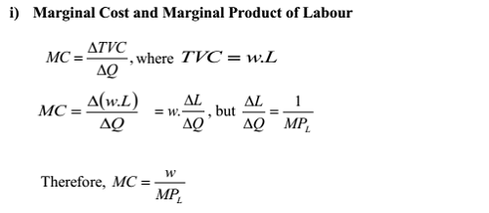
4.3 The relationship between short run production and cost curves
Suppose a firm in the short run uses labour as a variable input and capital as a fixed input.
Let the price of labour be given by w, which is constant.
Given these conditions, we can derive the relation between MC and MPL as well as the relation between AVC and APL.
.

Slide 28
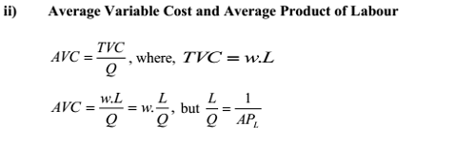
This expression also shows inverse relation between MC and MPL. When initially MPL increases, MC decreases; when MPL is at its maximum, MC must be at a minimum and when finally MPL declines, MC increases
inverse relation between AVC and APL.
When APL increases, AVC decreases; when APL is at a maximum, AVC is at a minimum and when finally APL declines, AVC increases.

Slide 29
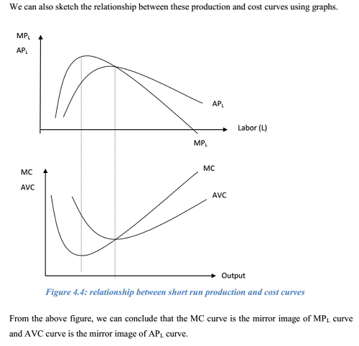
.

Slide 30
End of chapter four

